Slide 1
Effective Real-time Android Application Auditing
Presented by Lihua Ren

Slide 2





Personal data in mobile devices
1

Slide 3
Problem Definition
Abuses of personal data
Data leaks
Tamper user privacy
Abandon apps
Harming app developers
Harming app market
intentionally
e.g. for improper advertising revenue
unintentionally
e.g. exposing there data in plain-text over public networks
2

Slide 4
Existing work
Analyze and identify data-leaking apps based on static program analysis:
AppIntent
Pios
Flowdroid
Merits ：
comprehensively examine program data flows
comprehensively reveal data-leaking code paths
Limitation ：
inefficient (time- and memory -consuming)
produces false alarms
3

Slide 5
Outline
Problem definition
Prior work
AppAudit (new idea)
Design overview
Efficient Static API Analysis
Approximated Execution
Evaluation
Discussion
4

Slide 6

Approach of this study
Approach:
AppAudit: a program analysis framework that can analyze apps efficiently and effectively.
In real-time
Report actual data leaks
http://californiasupplementalexam.com/2014/01/setting-goals-to-pass-the-cse-in-2014/
5

Slide 7
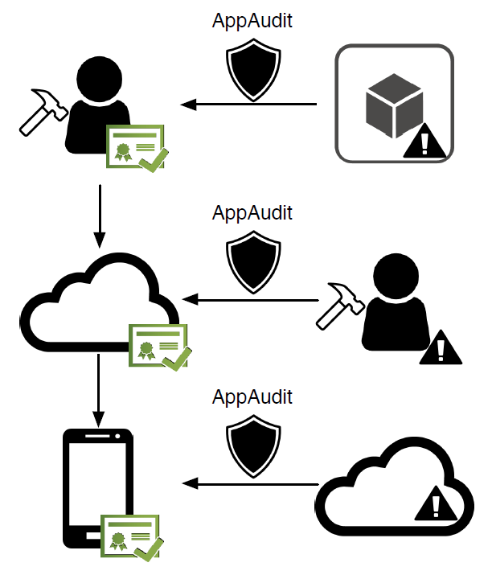
AppAudit: Use cases
integrated into IDEs to check apps for developers before release
identify problematic 3rd-party modules
deployed as an automatic app auditing service at app markets
wipe out human involvement in validating analysis results
installed on mobile devices to check apps before installation
protect users against data-leaking apps from untrusted sources or app markets that lack auditing service
6

Slide 8
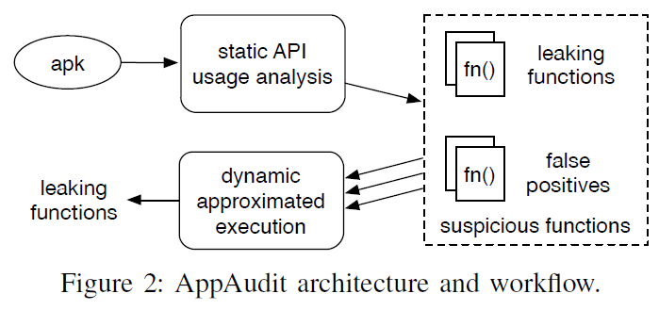
AppAudit: Design overview
Goal: tackle analysis efficiency and false positives
Idea: 2 steps
start with a very lightweight static API analysis
rely on a dynamic analysis to prune its false positives
7

Slide 9
Tackle false positives
Static analysis solutions (existing work) VS AppAudit
Static analysis solutions: explore all code paths
AppAudit: only explores code paths that could happen in real -> few false positives
Challenge of AppAudit
When dynamic analysis meets unknowns, it can hardly explore deeply into code paths, which will cause false negatives.
Approach of AppAudit
design a novel object model to represent and propagate unknowns
design several execution mechanisms to increase the depth of our analysis and avoid false negatives
8

Slide 10
Step 1: Efficient Static API Analysis
Goal:
Efficiently find functions that can potentially cause data leaks
Essential conditions for data leak
Reach a Source API to retrieve personal data
Reach a Sink API to transmit data out of the device
Finding data leak
〓 Finding one path
from the function to a source API and another to a sink API
9

Slide 11
Step 1: Efficient Static API Analysis (CONT)
API Usage Analysis
Firstly ,build a standard call graph from program bytecode
Then extend it
Finally, perform a breadth-first search to mark all suspicious functions
Why extend? how to extend?
10

Slide 12
Call Graph Extensions
Traditional call graph
Missing paths: Dynamic Java language features, Android programming model
AppAudit: Call Graph Extensions
Java Virtual Calls and Reflection Calls
Assume virtual calls can reach any matching method from all inherited classes while a reflection call will directly be marked suspicious
Static Fields as Intermediates
Android Life Cycle Methods
Multi-threading
GUI Event Callbacks
Android Remote Procedure Call (RPC)
11

Slide 13
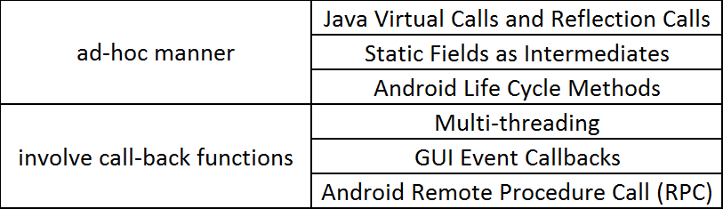
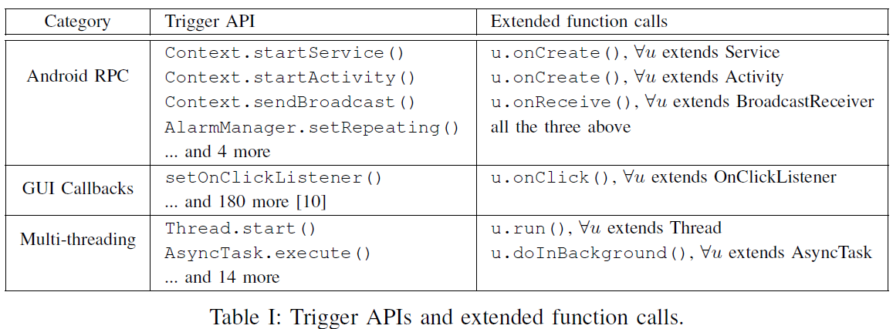
Call Graph Extensions(CONT)
12

Slide 14
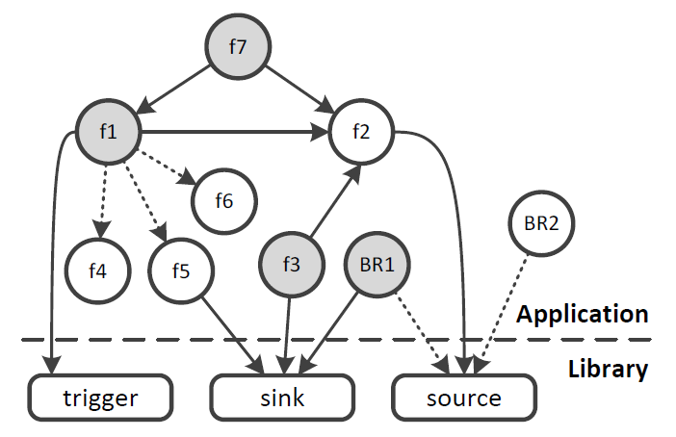
Call Graph Extensions(CONT)
13

Slide 15
Step 2: Approximated execution
Definition
A dynamic analysis that executes the bytecode instructions of a suspicious function and reports when data leak happens
Component
typical register set
a program counter (pc)
a call stack as its execution context
3 working modes
“execution (exec)” mode: interpret bytecodes and perform operations
“check” mode: check the parameters for the sink API
“approximation (approx)” mode: facing unknown -> switch to this mode for approximations to continue the execution.
14

Slide 16
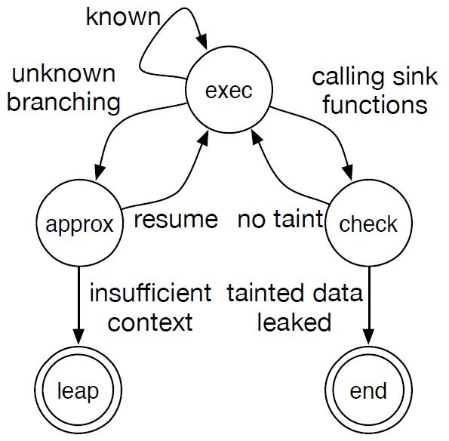
Approximated Executor State Machine
exec: Tainted objects propagate with the execution and taint any object derived from them
check: Tainted objects are found, report and terminate (“end” final state); otherwise, revert back
approx: If fail, enter “leap” final state
leap: terminate current execution and start executing one of its caller function
15

Slide 17


Object Representation
Type: i.e. int, long, string
object kind:
concrete object (CON): created during the execution process
prior unknown (PU): exist prior to the execution process and contain unknown values
derived unknown (DU): a prior unknown but is changed during the execution process
store the known value(s) of the object
i.e.
Unknown value
16

Slide 18
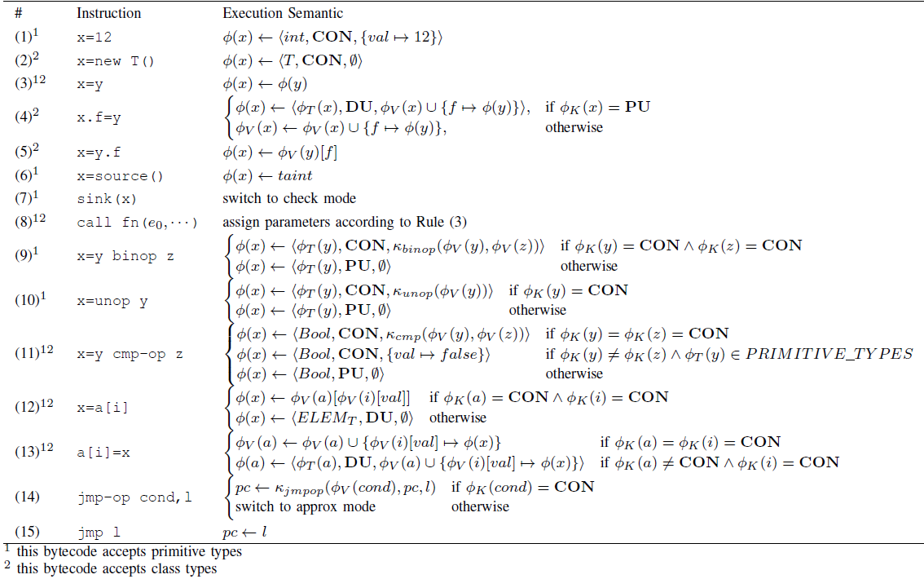
Execution Rules (Table Ⅱ)
17

Slide 19
Taint
Taint representation:
Tainting rules
Personal data is marked as tainted.
Taints propagate along with the object.
If a sink API meets a tainted object, report a leak.
18

Slide 20

Approximation Mode
When to change to approximation mode:
a conditional jump instruction meets unknown values
Unknown Branching Approximation
Idea:
skip unknown loop as these loops cannot provide useful known information from unknowns.
http://californiasupplementalexam.com/2014/01/setting-goals-to-pass-the-cse-in-2014/
19

Slide 21
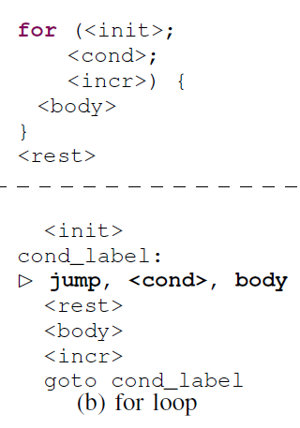
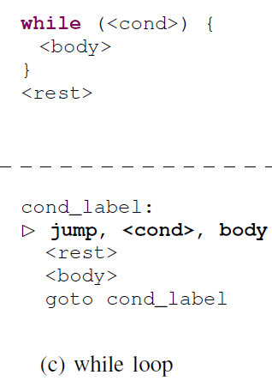
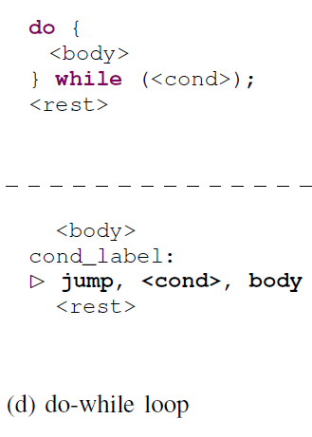
Unknown Branching Approximation
Choose not to take the conditional branch to skip these loops
20

Slide 22
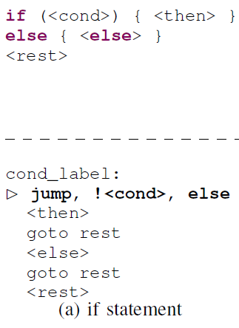
Unknown Branching Approximation
Cannot distinguish ifs and loops
->
Only explore the “then” branch for unknown if-else structures
->
This bias is benign
21

Slide 23


Accuracy Analysis
Execution mode:
faithfully reproduce the actual path of the real execution
Approximation mode:
only misses non-leaking paths and is benign to the overall accuracy
Limitations of Taint Analysis
Taint Sanitization:
only add and propagate taints but never remove them -> inaccuracy and false positives. (i.e. )
Array Indexing:
i.e. , will be tainted if is tainted. -> over-taints -> false positives
Control Flow Dependent Taints :
x, y are correlated but it always produce untainted y
22

Slide 24
Outline
Problem definition
Prior work
AppAudit (new idea)
Design overview
Efficient Static API Analysis
Approximated Execution
Evaluation
Discussion
23

Slide 25
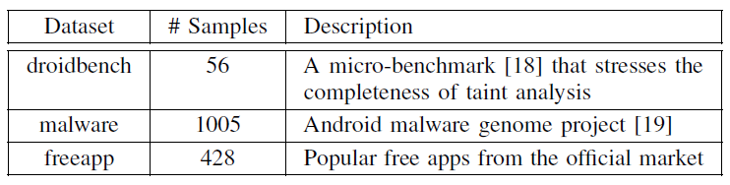
Evaluation
Methodology:
Completeness of Static API Analysis: by micro-benchmark
Detection Accuracy: by malware samples
Usability: by real-word apps
Characterization of Data Leaks in Real Apps: to provide guidance
Evaluation datasets:
24

Slide 26

Completeness of Static API Analysis
FlowDroid: a state-of-the-art pure static analysis tool
False negatives:
When: particular user inputs happen in a particular order
Why: AppAudit cannot model infinite possibility of user input orderings
Explanation: Some particular ordering of user inputs might imply user awareness of the data leak, so a detection tool should not report such leaks.
25

Slide 27
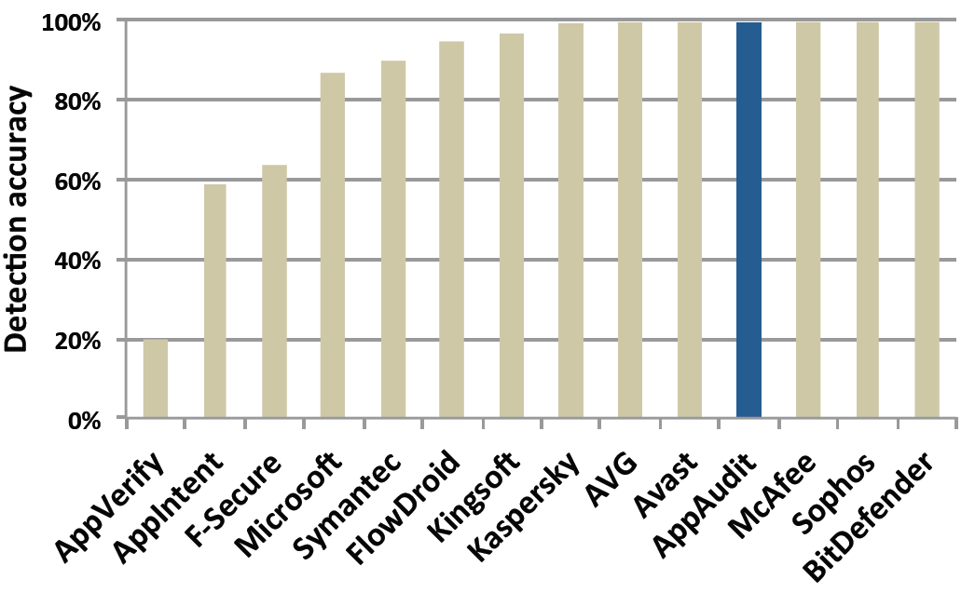
Detection Accuracy
19

Slide 28
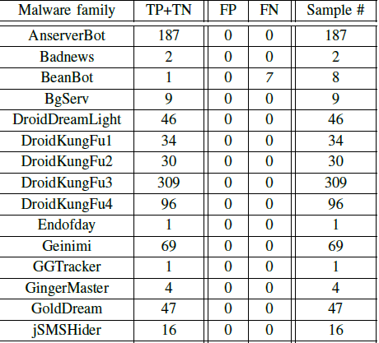
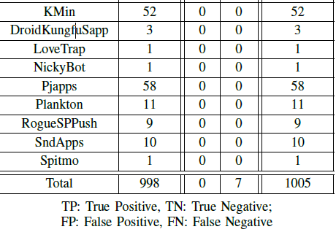
Detection Accuracy
19

Slide 29
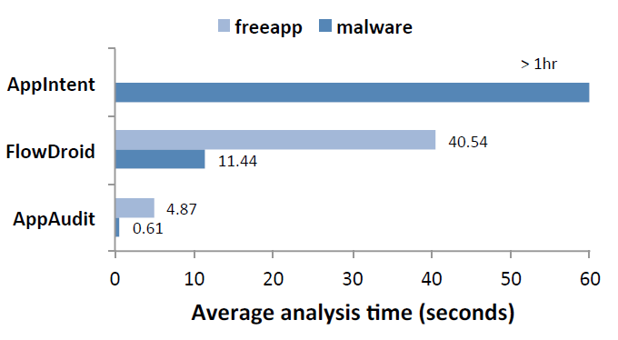
Usability
19

Slide 30
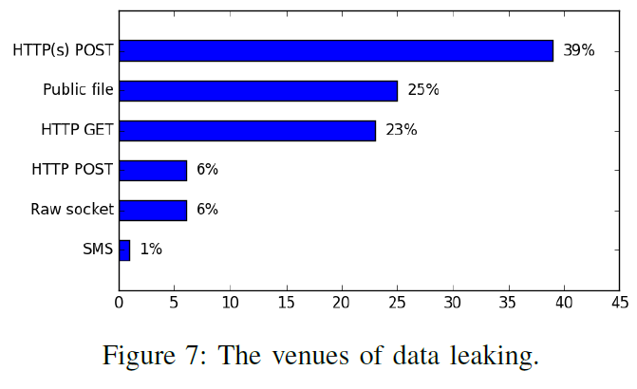
Characterization of Data Leaks in Real Apps
19

Slide 31
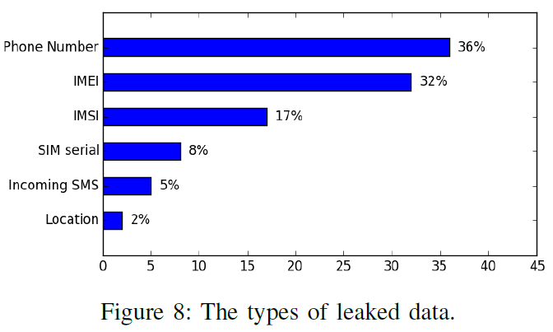
Characterization of Data Leaks in Real Apps
19

Slide 32
Questions
Question 1:
AppAudit adopts a two-stage design. What are the two stages and their responsibilities?
Question 2:
what might lead to approximation failure?
Question 3:
Unknown branching approximation Only explores the “then” branch for unknown if-else structures, but this bias is benign. Why?
44

Slide 33
Thanks！

